Slide 1




Executive Summary Presentation

Slide 2
Table of Contents
Introduction
Problem statement
Goals & Objectives
Proposed Solution
Benefits & Cost Analysis
Conclusion
Recommendations

Slide 3

01
INTRODUCTION

Slide 4
INTRODUCTION
Social engineering incidents have progressively increased over the past few years, endangering all types of businesses. According to a review of recent data, social engineering is responsible for around 30% of all security problems. As attackers create more advanced methods for manipulating and taking advantage of victims, it is projected that this percentage will rise even more. Social engineering is a prevalent tactic used by attackers to get access to resources and sensitive data because it doesn't require technical expertise to execute.

Slide 5
02
PROBLEM STATEMENT

Slide 6
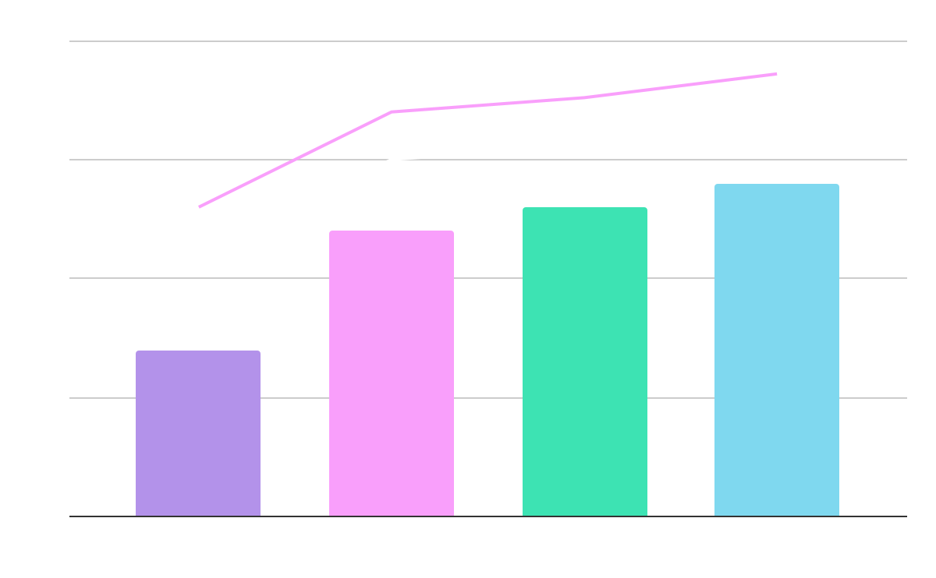
Problem statement
Phishing
Baiting
Phishing emails are over 35%.
Baiting has been done on > 60% employees.
Tailgating
Spear Phishing
35%
60%
65%
70%
The attack has been done for more than 65% in the last quarter.
The attack has been successful with more than 70% success rate.
The graph shows the types & number of social engineering attack on the organization in the recent years.

Slide 7
03
GOALS & OBJECTIVES

Slide 8
Goal planner
QUARTER
The Goal
Q1
Develop a comprehensive social engineering awareness program for all employees
Q2
Implement a comprehensive security monitoring system
Q3
Implement a process for regularly evaluating the effectiveness of the security monitoring system and the social engineering awareness program.
Q4
Review and update the organization's security policies and procedures

Slide 9
Monthly schedule
Test 1
SUN | MON | TUE | WED | THU | FRI | SAT
30 | 1 | 2 | 3 | 4 | 5 | 6
7 | 8 | 9 | 10 | 11 | 12 | 13
14 | 15 | 16 | 17 | 18 | 19 | 20
21 | 22 | 23 | 24 | 25 | 26 | 27
28 | 29 | 30 | 31 | 1 | 2 | 3
Simulations would be run to check the effectiveness of security measures.
Test 2
Conducting a review of any reported suspicious activity or communications

Slide 10
Objectives
Security Policy
Training
Monitoring
Report
Email Security
Password Policy
A policy that includes strict rules for handling sensitive information.
Training the employees on the risks and help them identify.
Monitor employee activities for signs of social engineering attacks.
Establishing a process to report suspicious activity.
Implement a secure email system with anti-phishing features.
Implement strong passwords and review user accounts for suspicious activity.

Slide 11
04
PROPOSED SOLUTION

Slide 12
Divide the plans
Network Monitoring
Software Security
Monitor
Software
The NMteam allows to monitor all the suspicious activity and make changes constantly.
The SS team implements the relevant software changes to the system and pass information to the Mercury Team

Slide 13
Implementation of Different Resources
User Access Control
Vendor Work
Security Assessment
IRM
The system implements technical controls such as two factor-authentication.
This system creates secure backups.
This system reviews the company’s security system and pushes updates.
Establishes a system for reporting suspicious activity

Slide 14
05
COST & BENEFIT ANALYSIS

Slide 15
$150,000
Money saved from implementing response teams.

Slide 16
Percentages
Phishing
Baiting
Revenue
50%
70%
13%
Phishing attacks are dropped by 50%
70% of the incidents are mitigated.
Revenue spent on teams annually.

Slide 17
06
CONCLUSION

Slide 18
CONCLUSION
The Blue Team has successfully safeguarded the organization against the social engineering attack. Through the implementation of a comprehensive security strategy and a robust training program, the Blue Team has been able to detect, prevent, and mitigate any social engineering attacks on the organization. Going forward, the Blue Team will continue to monitor the organization's security posture, update its security strategies, and provide ongoing training to its personnel to ensure the highest level of protection against social engineering attacks.

Slide 19
THANK YOU

